Slide 1
Unit 8: Searching and Hashing
Prepared by
Gobinda Subedi
KIST, BIT

Slide 2
Introduction
Searching is a process of finding an element within the list of elements stored in any order or randomly. Searching is divided into two categories Linear and Binary search.
Sequential Search:
In linear search, access each element of an array one by one sequentially and see whether it is desired element or not. A search will be unsuccessful if all the elements are accessed and the desired element is not found.
In brief, Simply search for the given element left to right and return the index of the element, if found. Otherwise return “Not Found”.

Slide 3
Linear Search
Algorithm:
LinearSearch(A, n,key)
{
for(i=0;i<n;i++)
{
if(A[i] == key)
return i;
}
return -1;//-1 indicates unsuccessful search
}
Analysis:
Time complexity = O(n)

Slide 4
Binary Search:
Binary search is an extremely efficient algorithm. This search technique searches the given item in minimum possible comparisons. To do this binary search, first we need to sort the array elements. The logic behind this technique is given below:
First find the middle element of the array
compare the middle element with an item.
There are three cases:
If it is a desired element then search is successful
If it is less than desired item then search only the first half of the array.
If it is greater than the desired element, search in the second half of the array. Repeat the same process until element is found or search area exhausted.

Slide 5
Binary Search
Algorithm:
BinarySearch(A,l,r, key)
{ //l = left index, r = right index if(l= = r) //only one element
{
if(key = = A[l])
return l+1; //index starts from 0
else
return 0;
}
else
{
m = (l + r) /2 ; //integer division
if(key = = A[m])
return m+1; else if (key < A[m])
return BinarySearch(l, m-1, key) ;
else
return BinarySearch(m+1, r, key) ;
}
}

Slide 6
Time complexity of Binary Search
The question is, how many times can you divide N by 2 until you have 1? This is essentially saying, do a binary search (half the elements) until you found it.
For Binary Search, T(N) = T(N/2) + O(1) // the recurrence relation.
So, T(N) = O(log(N))

Slide 7
Hashing
Definition:
Hashing is a method for storing and retrieving records from a repository. It lets you insert, delete, and search for records based on a search key value. When properly implemented, these operations can be performed in constant time (O(1)). That is, Hashing provides the direct access of records in the file no matter where the record is in the file.
A hash system stores records in an array called a hash table. Hashing works by performing a computation on a search key K in a way that is intended to identify the position in Hash Table that contains the record with key K. The function that does this calculation is called the hash function, denoted by the letter (say h). Since hashing schemes place records in the table in whatever order satisfies the needs of the address calculation, records are not ordered by value.

Slide 8
Hashing Function
The goal for a hashing system is to arrange things such that, for any key value K and some hash function h, i = h(K) is a slot in the table such that 0 <= i < M, and we have the key of the record stored at (Hash Table) HT[i] equal to K.
The mapping between an item and the slot where that item belongs in the hash table is called the hash function. The hash function will take any item in the collection and return an integer in the range of slot names, between 0 and m-1.
Basically, A function that transforms a key into a table index is called a hash function.
A common hash function is h(k)=k mod ARRAYSIZE
if key=27 and SIZE=10 then hash address=27%10=7
Given a collection of items, a hash function that maps each item into a unique slot is referred to as a perfect hash function.

Slide 9
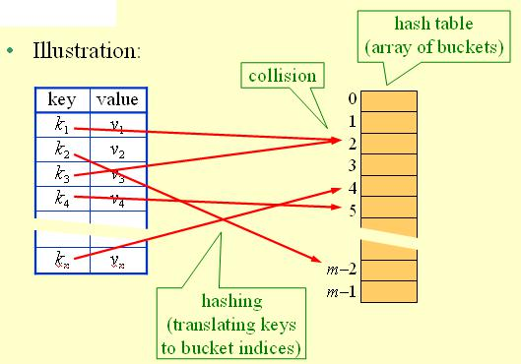
Hash Table Principal

Slide 10
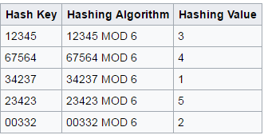
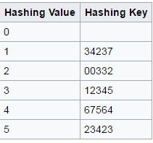
Hash Table Principal
Hashvalue = hashKey MOD 6
Hash table

Slide 11
Hash Collision
Hash Collision:
If two or more than two records trying to insert in a single index of a hash table then such a situation is called hash collision.
When two items hash to the same slot, we must have a systematic method for placing the second item in the hash table. This process is called collision resolution.

Slide 12
Collision Resolution
Some popular methods for minimizing collision are:
Linear probing
Quadratic probing
Rehashing
Chaining
Hashing using buckets etc
But here we need only first two methods for minimizing collision

Slide 13
Collision Resolution contd..
During insertion, the goal of collision resolution is to find a free slot in the hash table when the home position for the record is already occupied. We can view any collision resolution method as generating a sequence of hash table slots that can potentially hold the record.
The first slot in the sequence will be the home position for the key. If the home position is occupied, then the collision resolution policy goes to the next slot in the sequence. If this is occupied as well, then another slot must be found, and so on. This sequence of slots is known as the probe sequence, and it is generated by some probe function.

Slide 14
Collision Resolution contd..
One method for resolving collisions looks into the hash table and tries to find another open slot to hold the item that caused the collision. A simple way to do this is to start at the original hash value position and then move in a sequential manner through the slots until we encounter the first slot that is empty.
Definition:
A hash-table in which a collision is resolved by putting the item in the next empty place within the occupied array space is called linear probing.
It starts with a location where the collision occurred and does a sequential search through a hash table for the desired empty location.
Hence, this method searches in straight line, and it is therefore called linear probing.

Slide 15
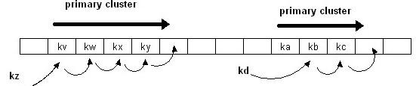
Collision Resolution:Linear Probing
A disadvantage to linear probing is the tendency for clustering; items become clustered in the table. This means that if many collisions occur at the same hash value, a number of surrounding slots will be filled by the linear probing resolution. This will have an impact on other items that are being inserted.
This tendency of linear probing to cluster items together is known as primary clustering.

Slide 16
Collision Resolution: Quadratic Probing
Definition:
Quadratic probing is a collision resolution method that eliminates the primary clustering problem take place in a linear probing. A variation of the linear probing idea is called quadratic probing.
Here, we use a rehash function that increments the hash value by 1, 3, 5, 7, 9, and so on. This means that if the first hash value is h, the successive values are h+1, h+4 h+9, h+16, and so on. In other words, quadratic probing uses a skip consisting of successive perfect squares.

Slide 17
Collision Resolution: Quadratic Probing
When collision occur then the quadratic probing works as follows:
(Hash value + 1²)% table size
if there is again collision occur then there exist rehashing.
(hash value + 2²)%table size
if there is again collision occur then there exist rehashing.
(hash value + 3²)% table size
In general in ith collision
hi(x)=(hash value +i²)%tablesize

Slide 18
Examples of Linear and quadratic probing? We will do them in the class.

